Slide 1
Tremor Location Algorithm
Celso Reyes
PHYS 693

Slide 2
Outline
Problem Description
Basic Algorithm
From Matlab to supercomputer
  Fortran Rewrite
  Parallelizing
  Visualization

Slide 3

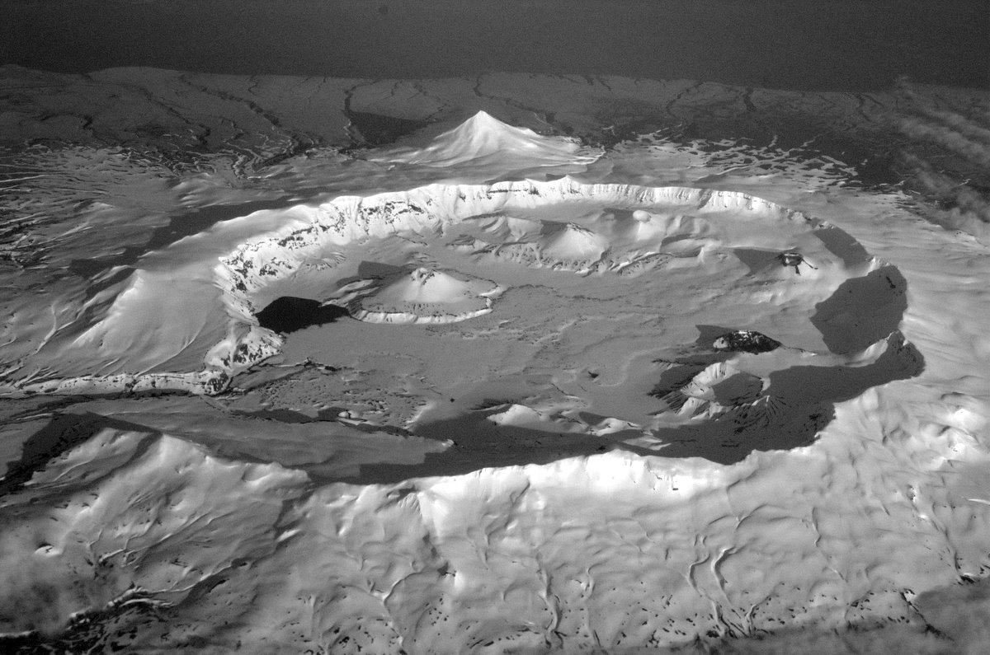







Geometry of the problem
Photo: Cyrus Read
Notes:
Discuss History over this slide!

Slide 4
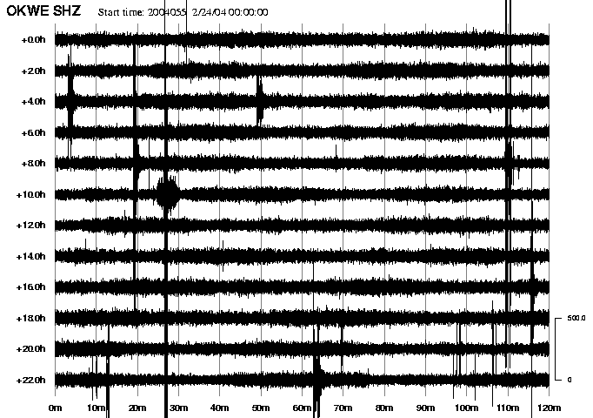
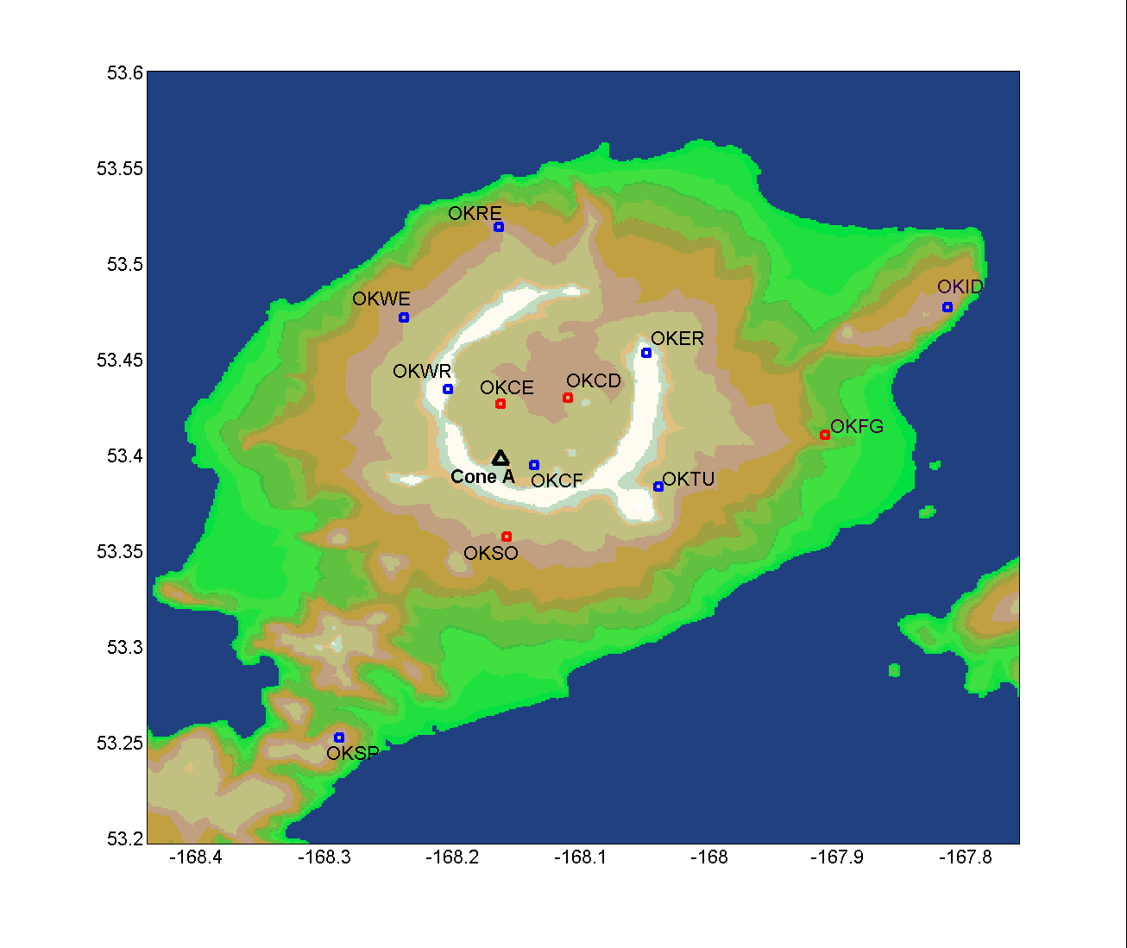
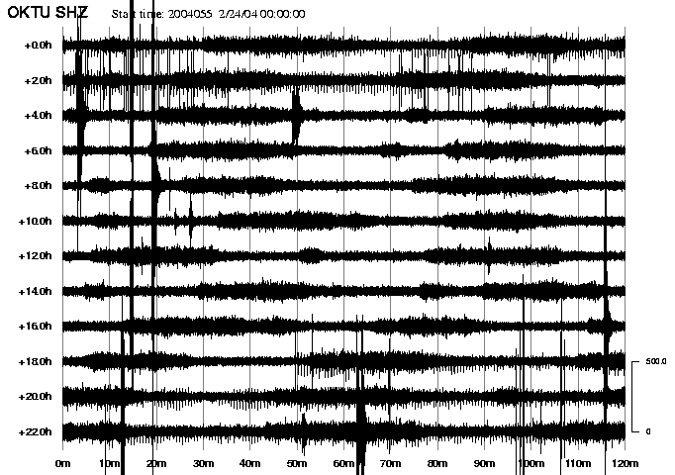
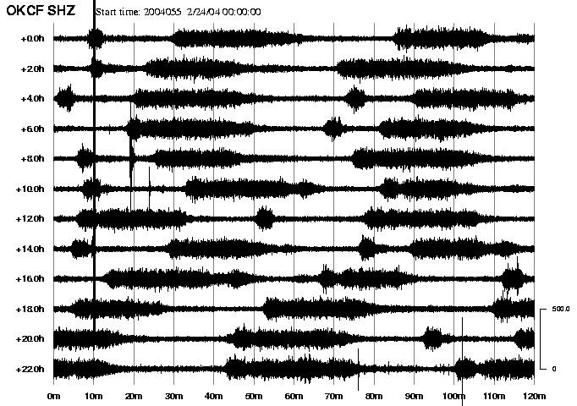
24 FEB 2004
Notes:
Green is for intertremor periods. tL = [tl(1:end-1) + 1, tl(2:end) – 1]
Red is for the short pulses (< 10 min)
Blue is for the longer pulses (>= 10 min)
Histogram shows these are divided into two groups. Nothing exists between 8 & 17 min duration.
Waveform = waveform(‘OKCF’,’SHZ’,’2/24/04 04:00:00’, ‘2/24/04 05:10:00’)
PSD Command: psd(data,2048,Fs,[])
For spectrogram s= spectralobject(2048,1948,10,[35 75])

Slide 5

Tremor Location Algorithm (setup)
Define Search Grid (Cells)
For each Cell (Do once):
  Calculate distance r to each station n
  For each r_{n}, determine how much signal would attenuate
For Signal at each Station (entire signal)
  Remove Site effect
  Remove Instrument effect
Notes:
A search grid is defined, with a number of cells that are sufficient to discriminate tremor location between the center of the caldera and Cone A. Depending on the sensitivity of the location program, the grid spacing will change. In practice, I’ve created the mesh based on available computational might, rather than according to the sensitivity of the data. Two methods of location will be used, surface and volume.
For each point of the search grid, I calculate the distance to each station. Then, I calculate the decay expected from each point to each station, using equations (5) and (6), depending on whether I’m using body or surface waves (i.e., surface, or volume). This decay value approximates the signal strength I would expect with a unit initial amplitude (A_{o} = 1).
Each of the attenuation functions can be rewritten as
Next, I solve for initial amplitudes at the closest station, , where r is the distance to the station with the highest amplitudes. A­_{o} becomes the basis of my amplitude search.
Using A­­_{o} , I recalculate expected amplitudes at each station. I then look for the best fit, where the variance of my observations is minimized. This provides a first-order fit, with both a best-fit location and amplitude. Then, I would iterate for nearby values of A_{o}, looking for the overall best fit amplitudes and durations. An example of this can be found in Figure 10.
Output of the program includes a map of scaled misfits, as well as variance values and best-fits at stations.

Slide 6
Tremor Location Algorithm (running)
For each Time Step
  Calculate signal strength A₀ required to match strongest observed Signal
    This is our source amplitude
    Initialized to get us out of any local minima and avoid parsing the entire spectrum of possible signal strengths
  Calculate signal at each station A_{c,n},
  Examine Variance as level of misfit
Notes:
A search grid is defined, with a number of cells that are sufficient to discriminate tremor location between the center of the caldera and Cone A. Depending on the sensitivity of the location program, the grid spacing will change. In practice, I’ve created the mesh based on available computational might, rather than according to the sensitivity of the data. Two methods of location will be used, surface and volume.
For each point of the search grid, I calculate the distance to each station. Then, I calculate the decay expected from each point to each station, using equations (5) and (6), depending on whether I’m using body or surface waves (i.e., surface, or volume). This decay value approximates the signal strength I would expect with a unit initial amplitude (A_{o} = 1).
Each of the attenuation functions can be rewritten as
Next, I solve for initial amplitudes at the closest station, , where r is the distance to the station with the highest amplitudes. A­_{o} becomes the basis of my amplitude search.
Using A­­_{o} , I recalculate expected amplitudes at each station. I then look for the best fit, where the variance of my observations is minimized. This provides a first-order fit, with both a best-fit location and amplitude. Then, I would iterate for nearby values of A_{o}, looking for the overall best fit amplitudes and durations. An example of this can be found in Figure 10.
Output of the program includes a map of scaled misfits, as well as variance values and best-fits at stations.

Slide 7
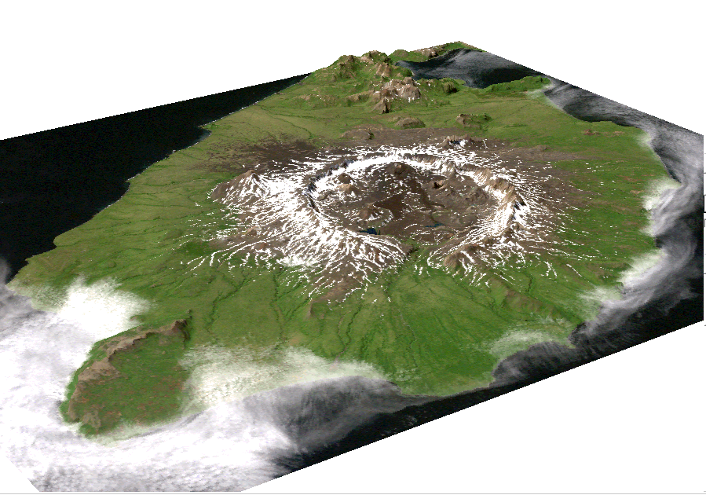
Algorithm Step Through

Slide 8





Algorithm Step Through
INPUT DATA:
Amplitudes at each Station,
Station Locations

Slide 9




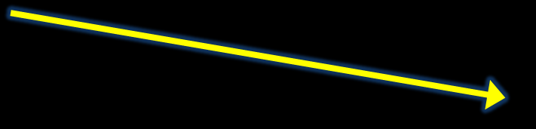
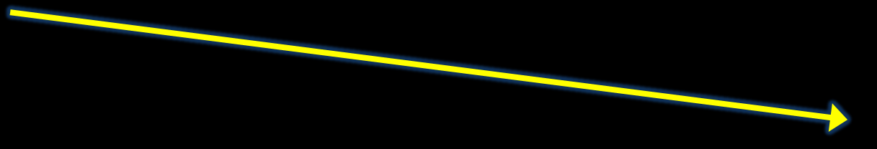
Algorithm Step Through
Calculate the distance between each search grid point and each station

Slide 10







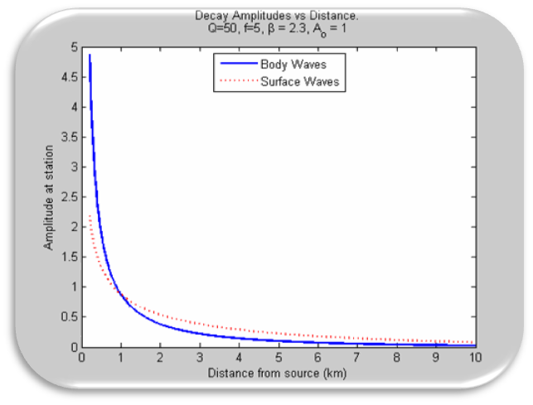
Algorithm Step Through
Calculate Expected signal decay between each point and station

Slide 11

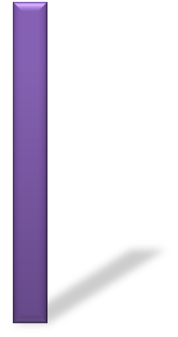





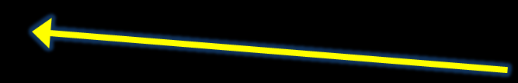

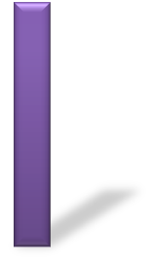
Algorithm Step Through
Calculate Source Strength at each point required to match Strongest A_{obs}

Slide 12



















Algorithm Step Through
With calculated A₀, Calculate Values for all other stations
Calculate the Misfit for each grid point
Σ_{station}(A_{obs} - A_{calc})²

Slide 13


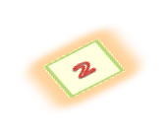


Algorithm Step Through
Assuming the Best Fit, a location and amplitude can now be determined

Slide 14
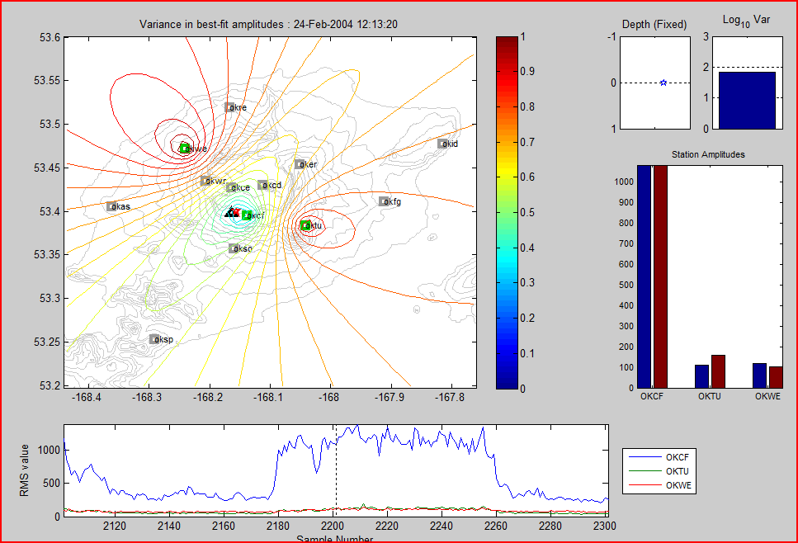
MATLAB Screenshot
Notes:
Example of output from the tremor location program. The location program is under revision, so this may not match exactly the output.
Pane 1: Topographic map of Okmok, with Cone A marked as the black triangle. All existing stations are shown as grey squares while active stations, those used in locating tremor, are colored green squares. Colored contours are the normalized variance. The red star is the best-fit location of tremor. The size of the red star indicates relative signal strength.
Pane 2: Measure of the best-fit variance.
Pane 3: Bars showing the magnitude of the observed signal at each observing station (blue), along with the calculated amplitudes at each station (red, not shown in this example).
Pane 4: Plot showing the portion of the signal for which this location was calculated.

Slide 15
Converting to Fortran
Learn the Language…
Decide how “raw” the raw data would be
Convert data .MAT files → ASCII data files
Translate from Classes → Modules

Slide 16
Bad Starts
Tried to make everything too generic
  Variable Number of Stations
  Variable data length
  Waveform OBJECT

Slide 17
PARTS
FILE CONVERTER (to ascii)
WAVEFORM
TREMORLOCATOR
FILE CONVERTER (to Vis5d)

Slide 18
Output involves 3 files
.hdr
  Used by tremloc_misfits_to_v5d.f90. ASCII.
.bin
  Binary output of all misfits (ever)
.best
  Best locations, depths, amplitudes. ASCII.

Slide 19
.best results
Sample Longitude Latitude Depth Best Amp Misfit
1 -168.1398 53.4667 5.00 285.3 124.6
2 -168.1284 53.4747 5.00 295.2 77.9
3 -167.7646 53.4384 5.00 2430.2 45.1
4 -167.7646 53.4424 5.00 2348.1 39.4
5 -168.0488 53.4263 5.00 164.1 29.6
6 -168.0488 53.4222 5.00 177.6 32.0
7 -167.7646 53.4343 5.00 2312.7 39.0
8 -168.0261 53.4182 5.00 164.9 19.4
9 -167.7646 53.4545 5.00 2263.8 31.0
10 -168.0375 53.4182 5.00 133.3 31.1

Slide 20
Tremorlocator.f90 – Main Loop
DO i = 1, sampN ! For each time step
singlesnippet = get_sample(waves,i,stat) !Get RMS value from all stations of interest
if (ANY(stat /= -1)) then
PRINT *, "Ack. File IO problem "
stop !exit! If the read failed, stop processsing and shut down normally
endif
! CALCULATE MISFIT
closest_station = MAXLOC(singlesnippet) !closest station is where amps are largest
do point_idx=1,total_points
! For each searchgrid, assume Ao fits largest observed amplitude
best_amplitudes(point_idx) = &
sum(singlesnippet(closest_station)* inverse_decay(closest_station , point_idx))
enddo
misfits = 0.0d0 !clear it out!
station_amps = 0.0d0 !clear it out!
delta_amps = 0.0d0 !clear it out!
! Calculate Misfit for each point by looping through points and stations.
!$OMP PARALLEL DO PRIVATE(this_misfit,alternate_misfit,j) SCHEDULE(guided)
do point_idx=1,total_points
this_misfit = calculate_misfit( &
best_amplitudes(point_idx), &
expected_decay(1:nStations, point_idx), &
singlesnippet(1:nStations))
!Wiggle amplitudes to get absolute best fit.
crawl forwards
crawl backwards
best_amplitudes(point_idx) = best_amplitudes(point_idx) + (j-1)
misfits(point_idx) = this_misfit
enddo ! point_idx
CALL calculate_bestfit(misfits, searchgrid, bestlocation(i),best_misfits(i), best_point_idx)
overall_best_amp(i) = best_amplitudes(best_point_idx)
! Write data out to file.
CALL io_add_misfit(fid_misfit,misfits,i,fileiostat) !i is recnum
CALL io_add_bestloc(fid_bestloc,bestlocation(i),fileiostat, i)
END DO

Slide 21
Tremorlocator.f90 – crawl
!Wiggle amplitudes to get absolute best fit.
j=15
do !crawl with smaller amplitudes
alternate_misfit =calculate_misfit(best_amplitudes(point_idx) - j, &
expected_decay(1:nStations, point_idx), &
singlesnippet(1:nStations))
if (alternate_misfit < this_misfit) then
this_misfit = alternate_misfit; j= j + 15 !take another spin
else
exit !we're not improving. kick outta here!
end if
end do !crawl with smaller amplitudes
best_amplitudes(point_idx) = best_amplitudes(point_idx) - (j)
! willfully overstep in the hopes of going faster while knowing we'll go
! in the the other direction ...right....now...
j = 1
do !crawl with larger amplitudes alternate_misfit =calculate_misfit( &
best_amplitudes(point_idx) + j,
expected_decay(1:nStations, point_idx), &
singlesnippet(1:nStations))
if (alternate_misfit < this_misfit) then
this_misfit = alternate_misfit
j = j + 1
!take another spin
else
exit !we're not improving. kick outta here!
end if
end do ! crawl with larger amplitudes

Slide 22
Where to parallelize?
Do Date (single value)
Do Sample (4320)
Do Points (60 x 100 x 10)
…Only One Date
… Great candidate for MPI
File output issues
… Lots of work to be done
Unknown # itterations/pt

Slide 23
Profile (on Linux)
Each sample counts as 0.01 seconds.
% cumulative self self total
time seconds seconds calls Ks/call Ks/call name
83.37 2909.83 2909.83 2145790004 0.00 0.00 __waveform__load_waveform
16.38 3481.57 571.75 1 0.57 3.48 MAIN__
0.00 3481.63 0.06 240000 0.00 0.00 __cr_geo__havsn
0.00 3481.65 0.02 960000 0.00 0.00 __cr_geo__deg2rad
0.00 3481.65 0.00 240000 0.00 0.00 __cr_geo__arc2km
0.00 3481.65 0.00 240000 0.00 0.00 __cr_geo__earthdistance_km
0.00 3481.65 0.00 4320 0.00 0.00 __waveform__get_sample_r1
0.00 3481.65 0.00 12 0.00 0.00 __waveform__display_a_waveform
0.00 3481.65 0.00 8 0.00 0.00 __waveform__make_waveform
0.00 3481.65 0.00 3 0.00 0.00 __cr_math__linspace
0.00 3481.65 0.00 2 0.00 0.00 __waveform__display_multiple_waveforms
0.00 3481.65 0.00 1 0.00 0.00 __cr_math__julian_day
0.00 3481.65 0.00 1 0.00 0.00 __cr_string__upcase
0.00 3481.65 0.00 1 0.00 0.00 __stationlocation__getokmokinfo
0.00 3481.65 0.00 1 0.00 0.00 __waveform__get_waveform_int
0.00 3481.65 0.00 1 0.00 0.00 __waveform__warn_if_uninitialize
Notes:
Incorrect!

Slide 24
Profile Results (iceflyer)
ngranularity: Each sample hit covers 4 bytes. Time: 5274.88 seconds
called/total parents
index %time self descendents called+self name index
called/total children
394.41 3205.36 1/1 .__start [2]
[1] 68.2 394.41 3205.36 1 .main [1]
3174.09 0.00 569586599/569586599 .@7@calculate_misfit [3]
29.47 0.00 4320/4320 .__waveform_NMOD_get_sample_r1 [6]
1.80 0.00 4320/4320 .@7@calculate_bestfit [10]
0.00 0.00 240000/240000 .__cr_geo_NMOD_earthdistance_km [40]
0.00 0.00 4322/4334 .__free [58]
0.00 0.00 6/4335 .__malloc [57]
0.00 0.00 2/2 .__waveform_NMOD_display_multiple_waveforms
0.00 0.00 1/1 .__stationlocation_NMOD_getokmokinfo
.
.

Slide 25
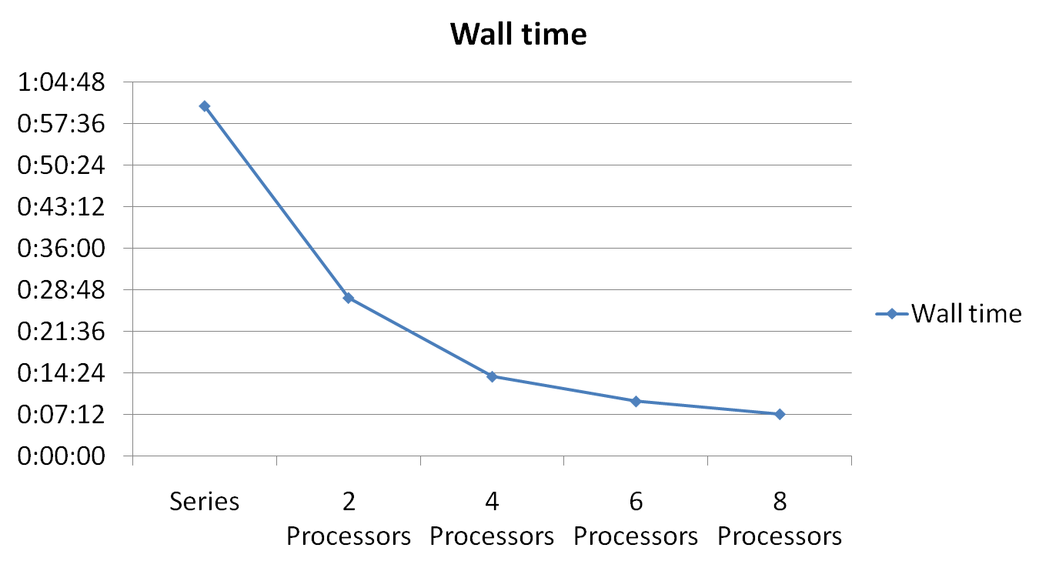
Time

Slide 26
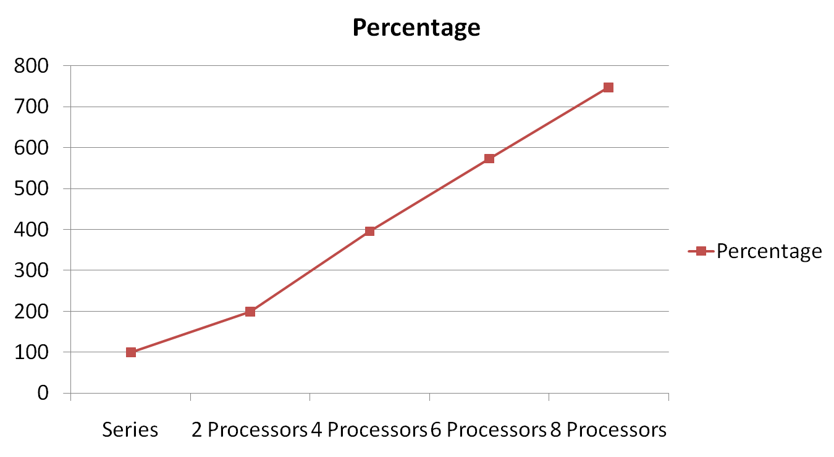
Processor Use

